Slide 1

Video #12
BEGINNER TO EXPERT GUARANTEED
NETWORKING - 1
ULTIMATE IT COURSE
ACCESS COURSE PLAYLIST LINK IN DESCRIPTION
SUBSCRIBE!!!

Slide 2
Answers
1. intel 9th gen Core i5 supported Socket? LGA1151
2. Which One is latest in RAM segment (DDR4/DDR5/SDRAM)
3. Which One is fast (HDD/External HDD/SSD/FLOPPY)
4. Name the Paste used while installation of Processor? THERMAL GREASE
5. List all Important things to build a pc ?
Microprocessor, RAM, SSD, GPU, Motherboard, SMPS, Monitor, Mouse, Keyboard, UPS & Speaker
Solve all question and comment down answers...

Slide 3

What is Internet ?
◆ The Internet is a global wide area network that connects computer systems across the world. It includes several high-bandwidth data lines that comprise the Internet "backbone." These lines are connected to major Internet hubs that distribute data to other locations, such as web servers and ISPs.

Slide 4
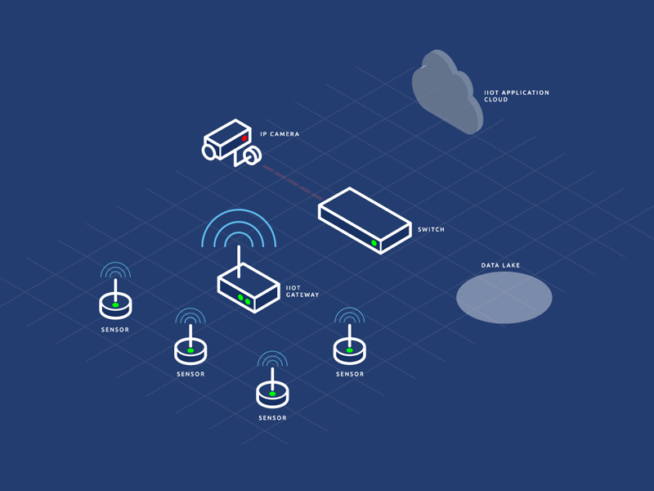
Networking in IoT
The IoT devices will most definitely need connectivity to the controllers that will be controlling the devices. The connectivity to the network could be wired or wireless. There are several protocol options in this space like zigbee, bluetooth, z-wave, 6LowPAN, WiFi, Cellular, NFC, Sigfix etc. The network will need to evolve to support these protocols that are common in the IoT world.

Slide 5

Networking in Hacking
If you want to be a script kiddie who watches YouTube tutorials and uses pre existing tools to hack into vulnerable systems, then not so much.
If you want to be a REAL hacker who can write their own payloads and discover system vulnerabilities themselves, then you need to know A LOT of NETWORKING and NETWORK SECURITY theory.

Slide 6
CERTIFICATIONS

Slide 7
Best Certifications
CCNA (Cisco Certified Network Associate)
CCNP (Cisco Certified Network Professional)
CCIE (Cisco Certified Internetwork Expert)
CompTIA N+ (CompTIA Network+)
Wireshark WCNA (Wireshark Certified Network Associate)
Basic Certifications

Slide 8

What is Network ?
◆ A network consists of two or more computers that are linked in order to share resources (such as printers and CDs), exchange files, or allow electronic communications.
◆ The computers on a network may be linked through cables, telephone lines, radio waves, satellites, or infrared light beams.

Slide 9
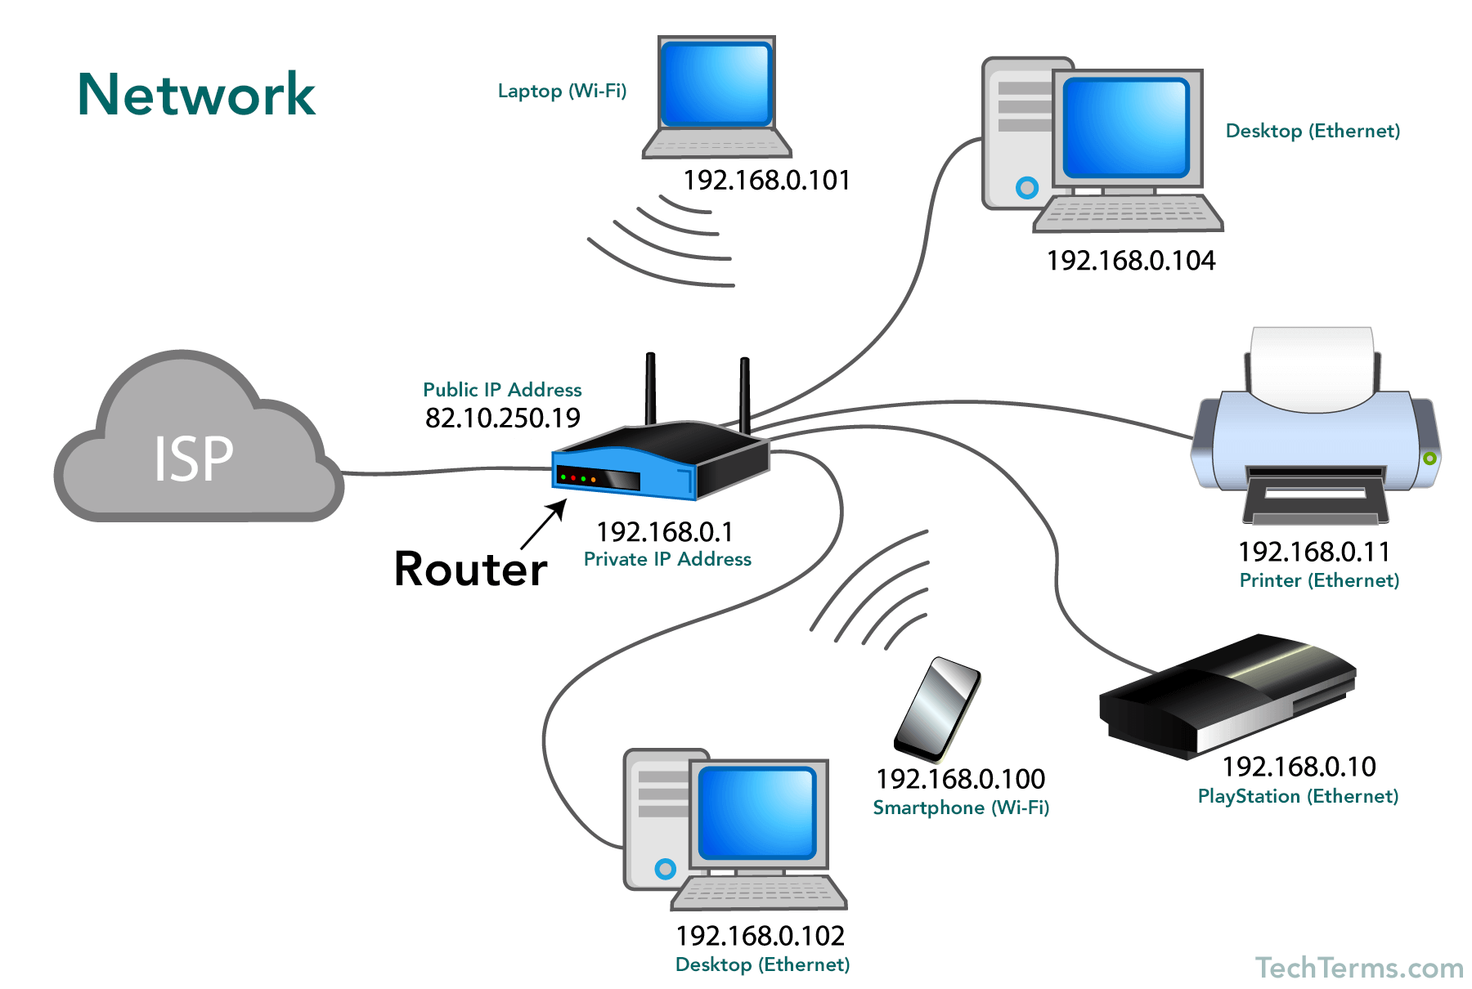

Slide 10
TYPES OF NETWORK
LAN :- Local Area Network
MAN :- Metropolitian Area Network
PAN :- Personal Area Network
CAN :- Campus Area Network
WAN :- Wide Area Network

Slide 11
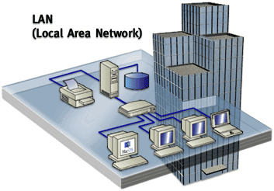
1. Local Area Network (LAN)
We’re confident that you’ve heard of these types of networks before – LANs are the most frequently discussed networks, one of the most common, one of the most original and one of the simplest types of networks. LANs connect groups of computers and low-voltage devices together across short distances (within a building or between a group of two or three buildings in close proximity to each other) to share

Slide 12
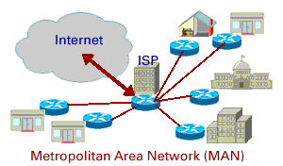
2. Metropolitian Area Network (MAN)
These types of networks are larger than LANs but smaller than WANs – and incorporate elements from both types of networks. MANs span an entire geographic area (typically a town or city, but sometimes a campus). Ownership and maintenance is handled by either a single person or company (a local council, a large company, etc.).

Slide 13
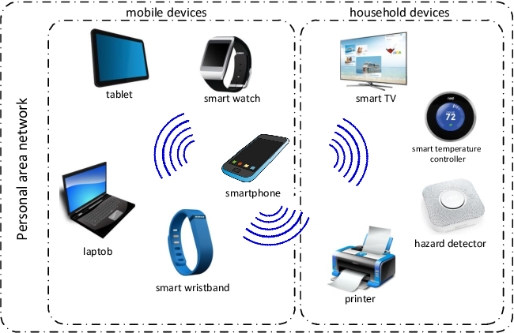
3. Personal Area Network (PAN)
The smallest and most basic type of network, a PAN is made up of a wireless modem, a computer or two, phones, printers, tablets, etc., and revolves around one person in one building. These types of networks are typically found in small offices or residences, and are managed by one person or organization from a single device.

Slide 14
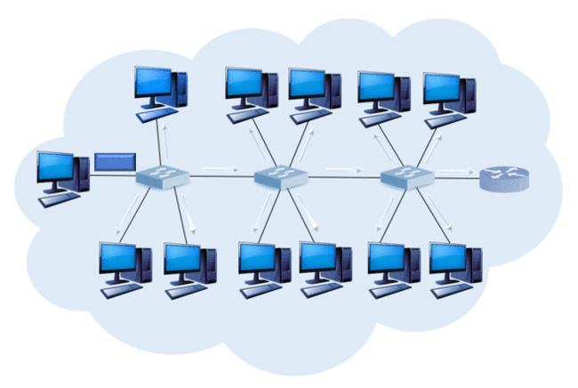
4. Campus Area Network (CAN)
Larger than LANs, but smaller than metropolitan area networks (MANs, explained below), these types of networks are typically seen in universities, large K-12 school districts or small businesses. They can be spread across several buildings that are fairly close to each other so users can share resources.

Slide 15
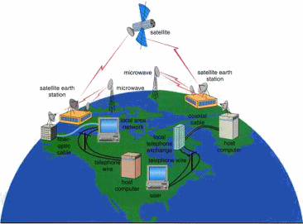
5. Wide Area Network (WAN)
Slightly more complex than a LAN, a WAN connects computers together across longer physical distances. This allows computers and low-voltage devices to be remotely connected to each other over one large network to communicate even when they’re miles apart.
The Internet is the most basic example of a WAN, connecting all computers together around the world. Because of a WAN’s vast reach, it is typically owned and maintained by multiple administrators or the public.

Slide 16
More Networks...
WPAN
WLAN
VPN
SAN
EPN

Slide 17
Questions:-
Abbrevation of CAN ?
Cisco Basic Certification for Networking ? (CCNA/CCNP/CCIE)
Connected Bluetooth Neckband is an example of ? (PAN/CAN/LAN/WAN)
Identify Delhi, Chennai, Kanpur & Sydney Network ? (MAN/LAN/WAN/WLAN)
Which Technology is used by WLAN & WPAN ?
Solve all question and comment down answers...

